Slide 1
Story of Acceptance

Slide 2
Impromptu Role Play
We need
Jesus
Woman
Two representative Pharisees
Everyone else will be a Pharisee

Slide 3
How this works
Text in black, we all read together As the actors act
- See text in red to see how we should act
- Text in blue is the kind of emotions we should put into the story
Have fun playing out the lines
You’re also welcome to exaggerate the scenes, but stick with the story (or at least bring it back!)

Slide 4
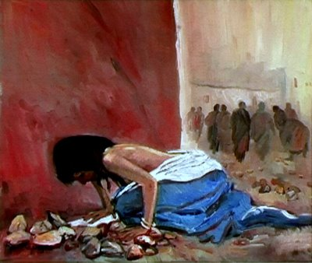
Story of Acceptance from John 8
As Jesus was speaking at the temple, the teachers of religious law and the Pharisees brought a woman who had been caught in the act of adultery. They put her in front of the crowd.
Treat her like an object
She’s going to die anyway!
She’s a terrible sinner

Slide 5
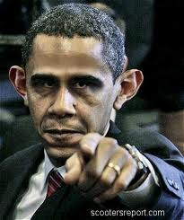





Story of Acceptance from John 8
“Teacher,” they said to Jesus, “this woman was caught in the act of adultery. The law of Moses says to stone her. What do you say?”
Point your fingers at her in disdain, it’s her fault, she is to blame for her wrongdoing

Slide 6

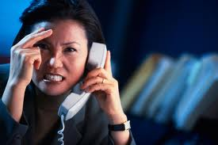


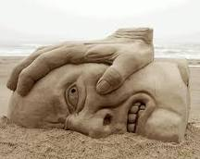
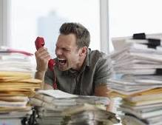
Story of Acceptance from John 8
They were trying to trap him into saying something they could use against him, but Jesus stooped down and wrote in the dust with his finger. They kept demanding an answer
Look to Jesus in anger! “Jesus, she deserves to die!!! Why are you wasting time? Condemn her now!”

Slide 7
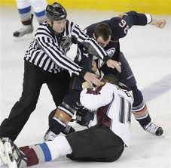
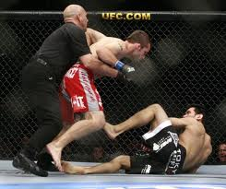
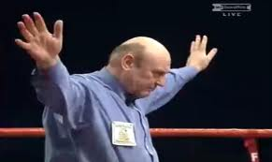
Story of Acceptance from John 8
So he stood up again and said, “All right, but let the one who has never sinned throw the first stone!” Then he stooped down again and wrote in the dust. When the accusers heard this, they slipped away one by one, beginning with the oldest, until only Jesus was left in the middle of the crowd with the woman.

Slide 8
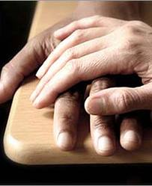
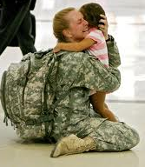
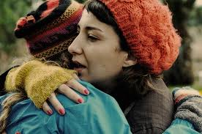
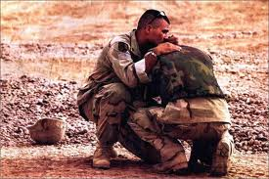
Story of Acceptance from John 8
Then Jesus stood up again and said to the woman, “Where are your accusers? Didn’t even one of them condemn you?”
“No, Lord,” she said.
And Jesus said, “Neither do I. Go and sin no more.”

